Slide 1
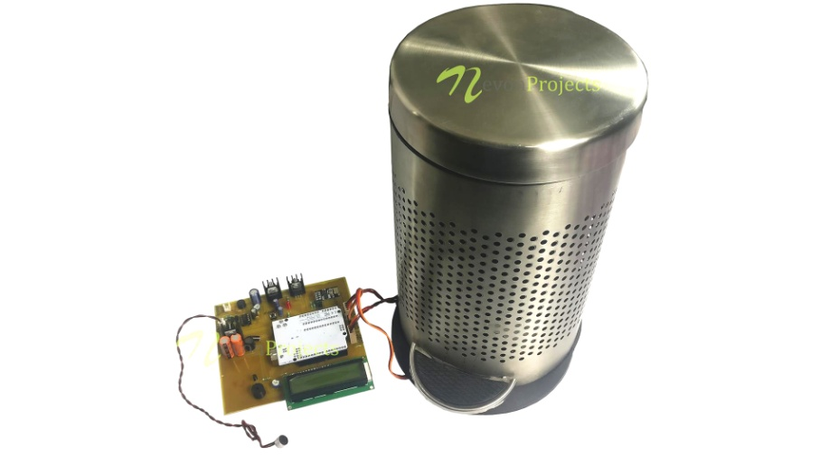
TEAM NAME:-IOTIANS
SMART WASTE MANAGEMENT
TEAM MEMBERS:-1.RUTHVIK
2.SAI PRIYA
3.SRIDHAR GOUD

Slide 2
ABSTRACT..........
With rapid increase in population, the issues related to sanitation with respect to garbage management are degrading immensely.
It creates unhygienic conditions for the citizens in the nearby surrounding, leading to the spread of infectious diseases and illness.
To avoid this problem, IoT based “Smart Waste Management” is the best and trending solution. In the proposed system, public dustbins will be provided with embedded device which helps in real time monitoring of level of garbage in garbage bins. The data regarding the garbage levels will be used to provide optimized route for garbage collecting vans, which will reduce cost associated with fuel. The load sensors will increase efficiency of data related to garbage level and moisture sensors will be used to provide data of waste segregation in a dust bin.

Slide 3
AGENDA :
Introduction
Hardware Components
Software Components
Block Diagram
Working
Output
Conclusion

Slide 4
INTRODUCTION.........
Worldwide interest in Smart Cities has aggrandized, fostered by the need to find effective remedies to the major challenges foreseen for the next years.
As one of the application of Smart City, Waste Management in a city is a formidable challenge faced by the public administrations.
Waste is defined as any material in which something valuable is not being used or is not usable and represents no economic value to its owner, the waste generator.
Depending on the physical state of the waste, they are categorized as solid waste and wet waste.

Slide 5
BLOCK DIAGRAM :
WEB APPLICATION
NODE MCU
ULTRASONIC SENSOR
IBM CLOUD
DHT 11 SENSOR
SERVO MOTOR
SMART BIN

Slide 6
HARDWARE COMPONENTS…………

Slide 7
NODE-MCU :
The ESP8266 is a low-cost Wi-Fi chip developed by Espressif Systems with TCP/IP protocol.
NodeMCU is an open source iot platform. It includes firmware which runs on the ESP8266 wi-Fi SoCcfrom Espressif Systems, and hardware which is based on the ESP-12 module .
The term "NodeMCU" by default refers to the firmware rather than the development kits. The firmware uses the Lua scripting language.
It is based on the eLua project, and built on the Espressif Non-OS SDK for ESP8266. It uses many open source projects, such as lua-cjson and SPIFFS.

Slide 8
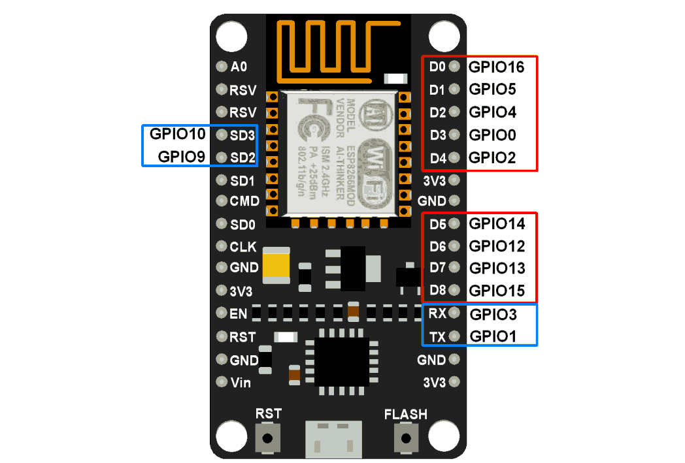
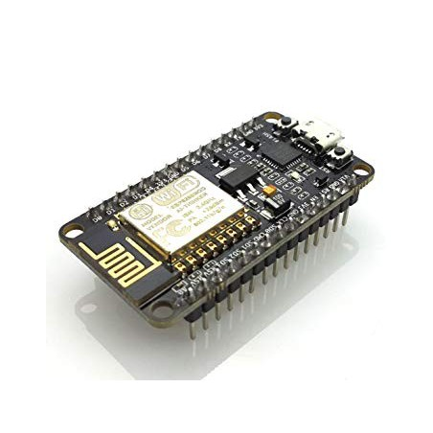

Slide 9
SERVO MOTOR :
A servo motor is an electrical device which can push or rotate an object with great precision.
If you want to rotate and object at some specific angles or distance, then you use servo motor. It is just made up of simple motor which run through servo mechanism.
If motor is used is DC powered then it is called DC servo motor, and if it is AC powered motor then it is called AC servo motor.
We can get a very high torque servo motor in a small and light weight packages.
Doe to these features they are being used in many applications like toy car, RC helicopters and planes, Robotics, Machine etc.

Slide 10
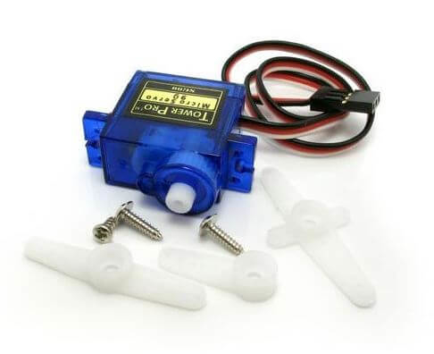

Slide 11
DHT11 SENSOr :
The DHT11 is a basic, ultra low-cost digital temperature and humidity sensor.
It uses a capacitive humidity sensor and a thermistor to measure the surrounding air, and spits out a digital signal on the data pin (no analog input pins needed).
Its fairly simple to use, but requires careful timing to grab data.
The only real downside of this sensor is you can only get new data from it once every 2 seconds, so when using our library, sensor readings can be up to 2 seconds old.

Slide 12
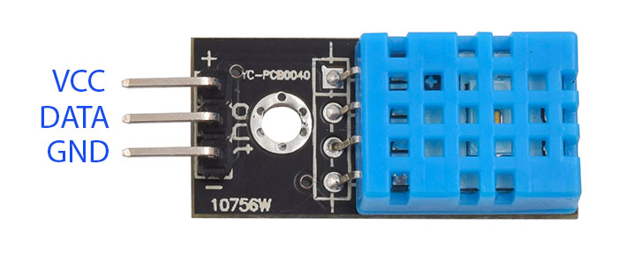
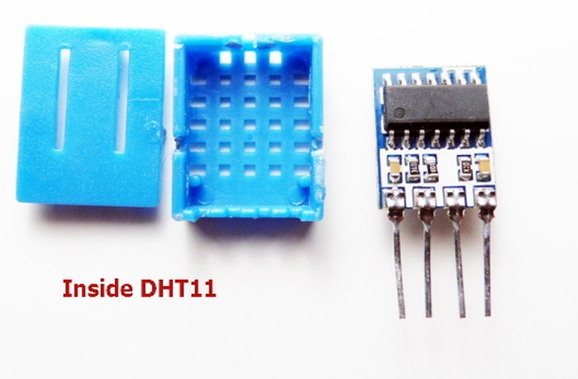

Slide 13
ULTRASONIC SENSOR :
Ultrasonic (US) sensor is a 4 pin module, whose pin names are Vcc, Trigger, Echo and Ground respectively.
This sensor is a very popular sensor used in many applications where measuring distance or sensing objects are required.
The module has two eyes like projects in the front which forms the Ultrasonic transmitter and Receiver. The sensor works with the simple high school formula that
Distance = Speed × Time
The Ultrasonic transmitter transmits an ultrasonic wave, this wave travels in air and when it gets objected by any material it gets reflected back toward the sensor this reflected wave is observed by the Ultrasonic receiver module

Slide 14
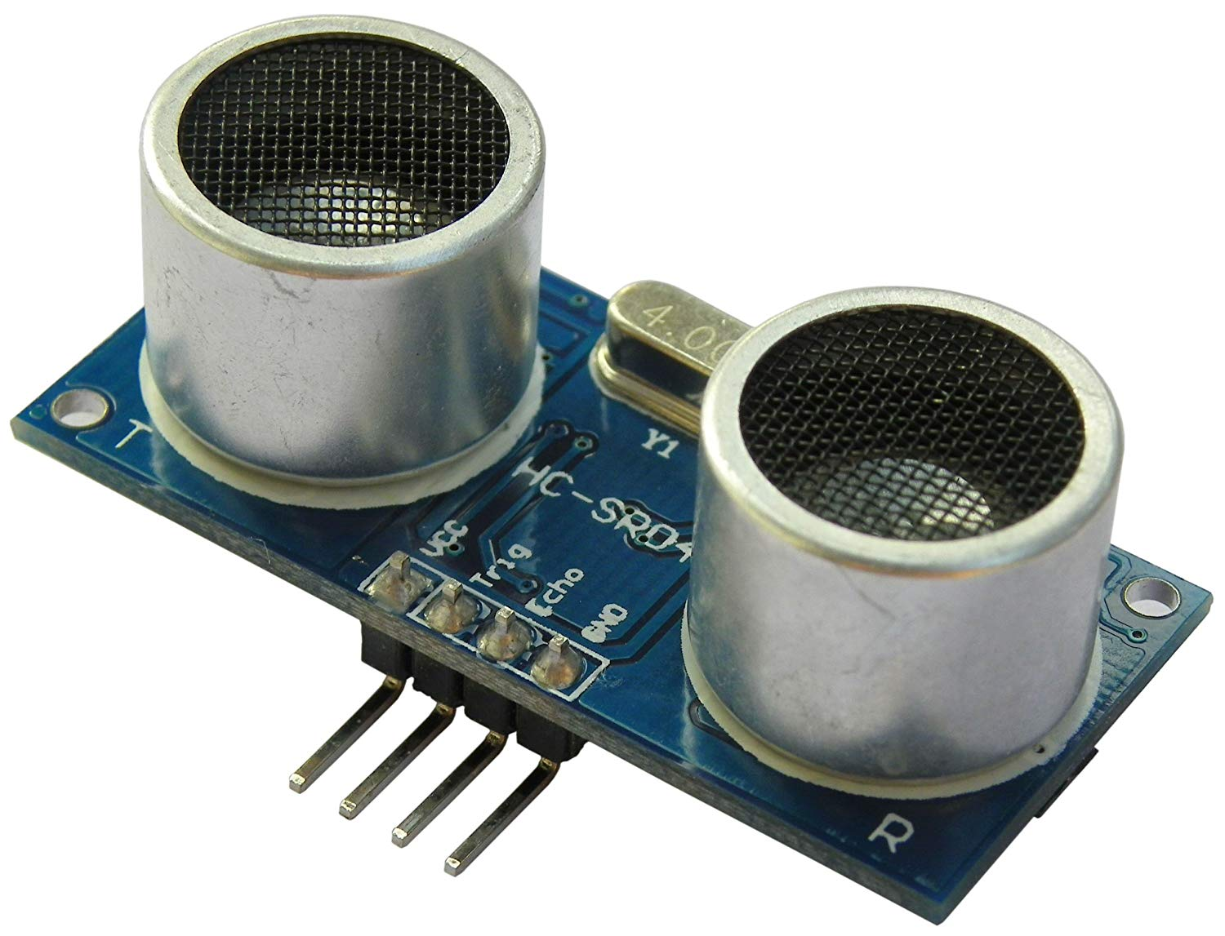
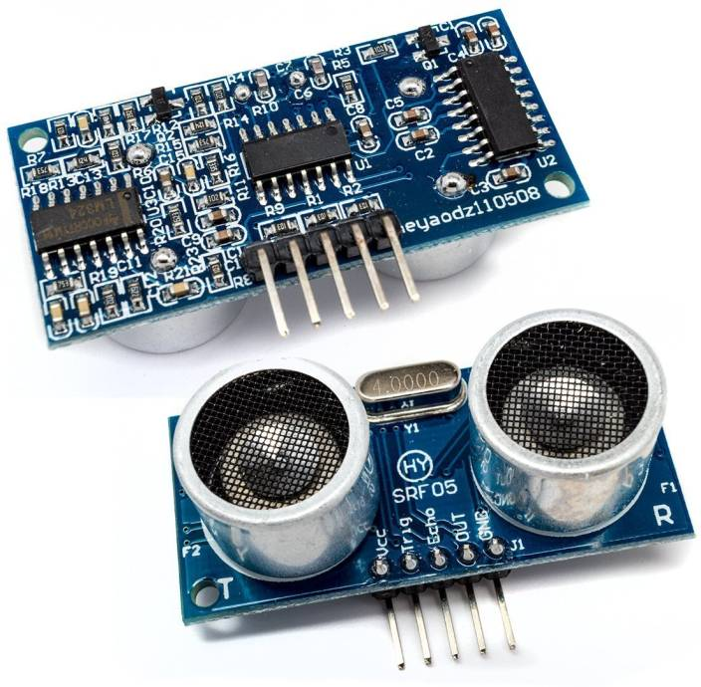

Slide 15
BASIC SHIELD………
This Basic Shield can be interface with 5V or 3.3V logic microcontroller boards like Arduino, AVR, PIC, 8051, ARM etc.
Basic Shield is very popular shield for interfacing of electronics component with microcontroller like LED’s, variable resistor, Push Button, LDR, buzzer etc.
All components are arranged in a proper manner so that you can use it with your microcontroller to learn basic programming of microcontroller in your projects.
This shield helps you how to deal with basic electronics component in your project.

Slide 16
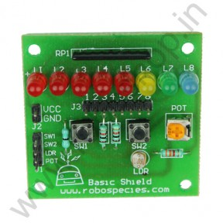

Slide 17
WORKING :
The garbage containers transmit signals to indicate that they are over 80% or 90% full and should be emptied Via the mobile communications network, the signals are sent to a web based software application used by the waste management company.
In the software, the capacity of the container is indicated, which is taken as a basis to plan the best route for waste collection garbage trucks travel only to those containers that actually need to be emptied.
A robust ultrasonic sensor is installed in the garbage container and detects the fill level regardless of what has been deposited inside. The whole system contains ULTRASONIC SENSOR, NODEMCU, SERVO MOTOR, DHT11,POWER SUPPLY.
The sensor is fixed on to the node mcu. the connection between the NODE MCU board and sensor is made with the help of connecting wires. The working program is fed into the NODE MCU board.
The SERVO MOTOR is also connected to the same NODE MCU board with the help of wires. The power supply to the system is given with the help of a battery.

Slide 18
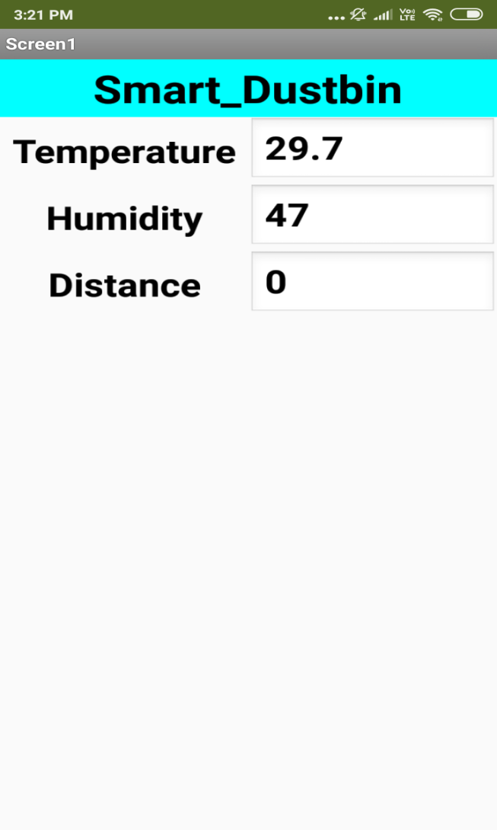
OUTPUT :

Slide 19
CONCLUSION :
This project work is the implementation of Automatic Garbage Fill Alerting system using Ultrasonic sensor, Node MCU, and servo motor.
This system assures the cleaning of dustbins soon when the garbage level reaches its maximum. It will take power supply with the help of Piezoelectric Device.
If the dustbin is not cleaned in specific time, 37 then the record is sent to the Sweeper or higher authority who can take appropriate action against the concerned contractor.
This system also helps to monitor the fake reports and hence can reduce the corruption in the overall management system. This reduces the total number of trips of garbage collection vehicle and hence reduces the overall expenditure associated with the garbage collection. It ultimately helps to keep cleanliness in the society.
Therefore, the Automatic Garbage Fill Alerting system makes the garbage collection more efficient.

